Slide 1
Operating Systems CS2006 Lecture: 2

Slide 2
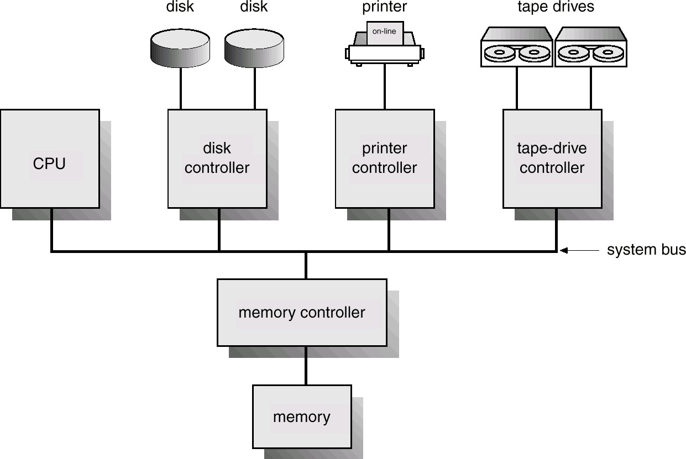
Computer-System Architecture

Slide 3
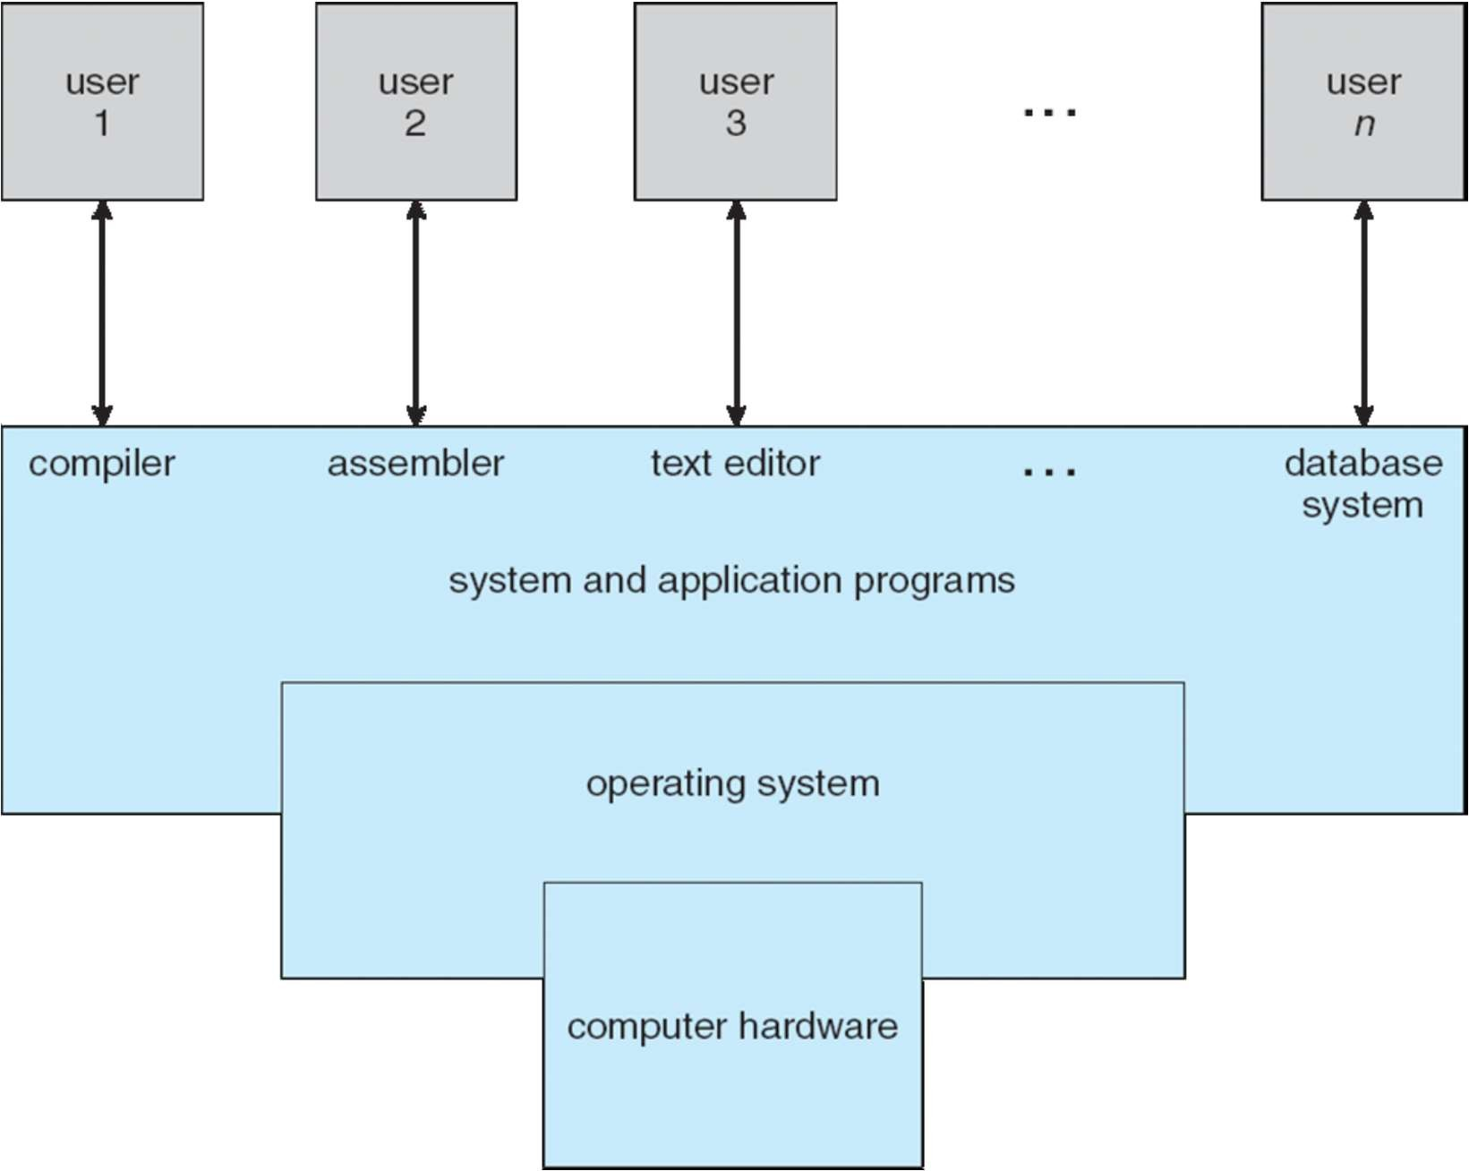
What is a Computer System?

Slide 4
Computer System
Consists of CPU and device controllers
Connected through a common Bus.
Providing access to shared memory
Each device controller is in charge of a specific device
Disk drives
Audio devices
Video display

Slide 5
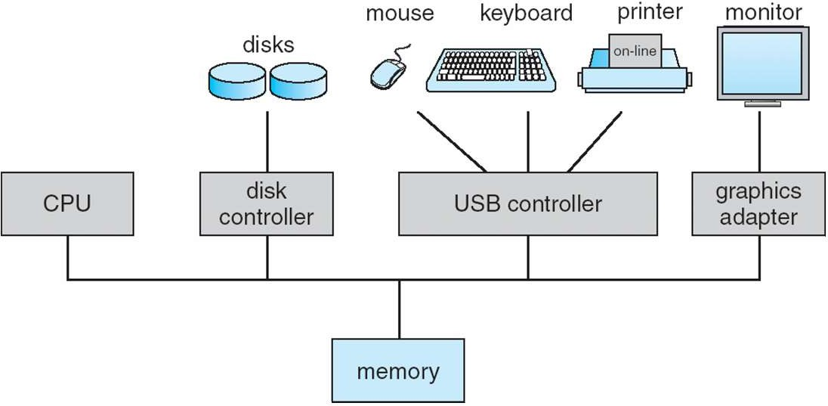
Computer System Organization
Computer-system operation
One or more CPUs, device controllers connect through common bus providing access to shared memory
Concurrent execution of CPUs and devices competing for memory cycles

Slide 6
Computer-System Operation
I/O devices and the CPU can execute concurrently
Each device controller is in charge of a particular device type
Each device controller has a local buffer
CPU moves data from/to main memory to/from local buffers
Cf) DMA (Direct Memory Access)
I/O is from the device to local buffer of controller
Device controller informs CPU that it has finished its operation by causing an
interrupt

Slide 7
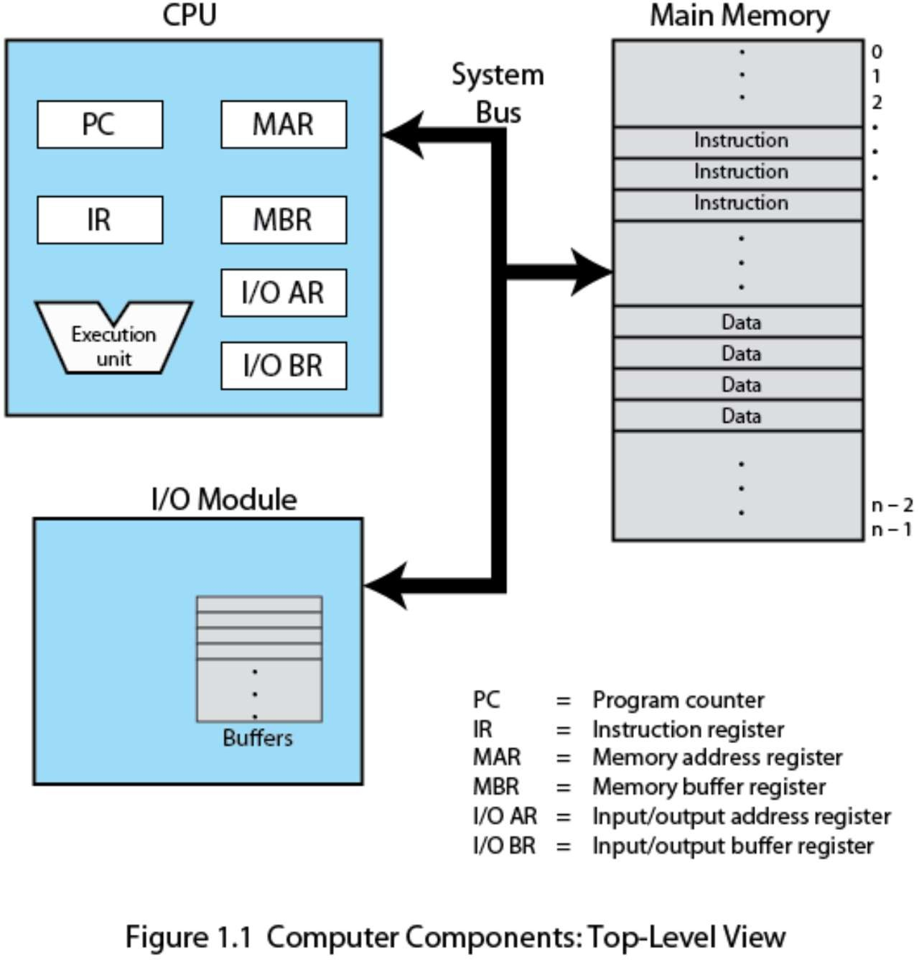
Major Computer Components

Slide 8
1- CPU
Registers
Program Counter (PC)
Instruction Register (IR)
Program Status Word (PSW)
General-purpose registers
Instruction Set Architecture
RISC vs. CISC
Intel, SPARC, MIPS, PowerPC, ARM, Alpha, …
Pipelining
Fetch, Decode, Execute, Write Back, etc.
Instruction-Level Parallelism(ILP)
Superscalar vs. VLIW
Simultaneous Multithreading

Slide 9
Processor
Internal Register
Memory Address Register (MAR)
Specifies the address for next read or write
Memory Buffer Register (MBR)
Contains data written into memory or receives data read from memory
I/O address register
I/O buffer register

Slide 10
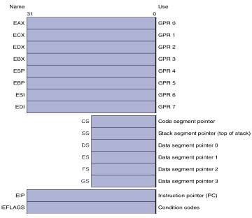
User-Visible Register
May be read by user processes
Available to all programs – application programs and system programs
Types of registers
Data
Address
Index
Segment pointer
Stack pointer
12

Slide 11
Control and Status Register
Program Counter (PC)
Contains the address of an instruction to be fetched
Instruction Register (IR)
Contains the instruction most recently fetched
Program Status Word (PSW)
Condition codes
Interrupt enable/disable
Supervisor/user mode

Slide 12
2- Memory Structure
Storage systems organized in hierarchy
Speed
Cost
Volatility
Caching
copying information into faster storage system
main memory can be viewed as a last cache for secondary storage

Slide 13
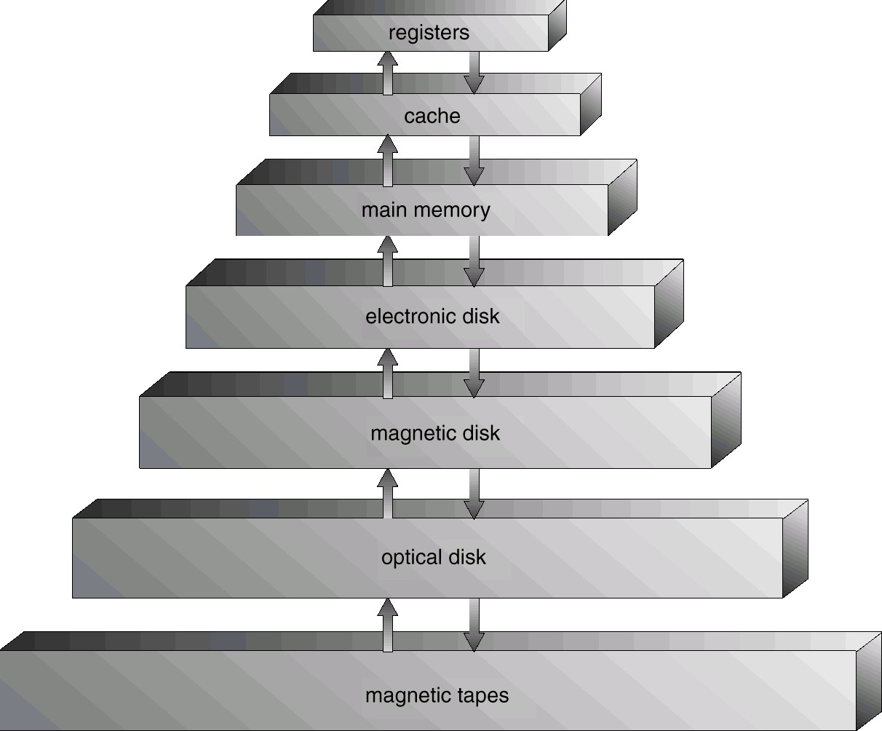
Storage-Device Hierarchy

Slide 14
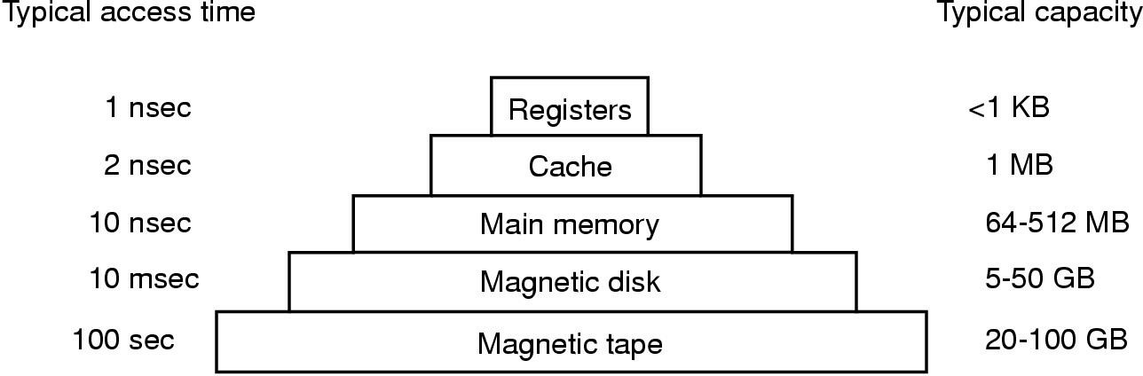
Memory Hierarchy

Slide 15
Caching
Use of high-speed memory to hold recently-accessed data
Requires a cache management policy
Write-through vs. Write-back
Caching introduces another level in storage hierarchy. This requires data that
is simultaneously stored in more than one level to be consistent
Cache coherency

Slide 16
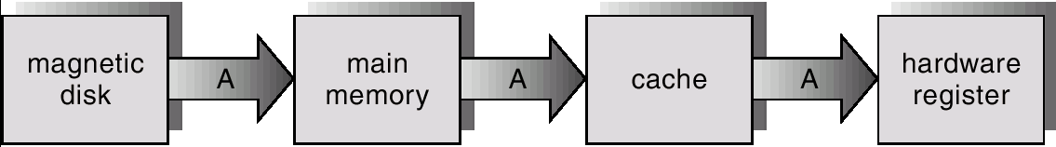
Migration of A From Disk to Register

Slide 17
3- I/O Structure
After I/O starts, control returns to user program only upon I/O completion
Wait instruction idles the CPU until the next interrupt
Wait loop (contention for memory access)
At most one I/O request is outstanding at a time, no simultaneous I/O processing
After I/O starts, control returns to user program without waiting for I/O
completion
System call – request to the operating system to allow user to wait for I/O completion
Device-status table contains entry for each I/O device indicating its type, address, and state
Operating system indexes into I/O device table to determine device status and to modify table entry to include interrupt

Slide 18
Device Controllers
I/O devices generally consists of two parts:
An Electronic component: Device Controller
A Mechanical component: The device itself
Each device controller is in charge of a specific device
It maintains
Some local storage buffer
A set of special purpose register
Accepts command from the Operating System
For example to read data from the device.

Slide 19
Device Controllers
A Device controller might accept a command:
Read
Sector 11,206
The device controller would:
Determine the current position of the head
Move the head to the required location
Accept data bit by bit
Store in a local buffer
Perform checksum on the data
Controllers contain small embedded programs to carry out all this work.

Slide 20
Device Drivers
Who would initiate the controller
Who would determine read/write
Who would tell the sector number
A part of operating system called Device Driver
Software or Hardware?
Software that talks to a controller
Gives it command
Accept Responses
Same for all controllers?
Different software for different type of controllers
Each controller manufacturer has to supply a driver for each operating system it supports

Slide 21
Device Status Table
One entry per I/O device
Keeps record of
Device’s type
Address
State
Not functioning
Idle
Busy
If the device is busy, the new request is saved in a queue

Slide 22
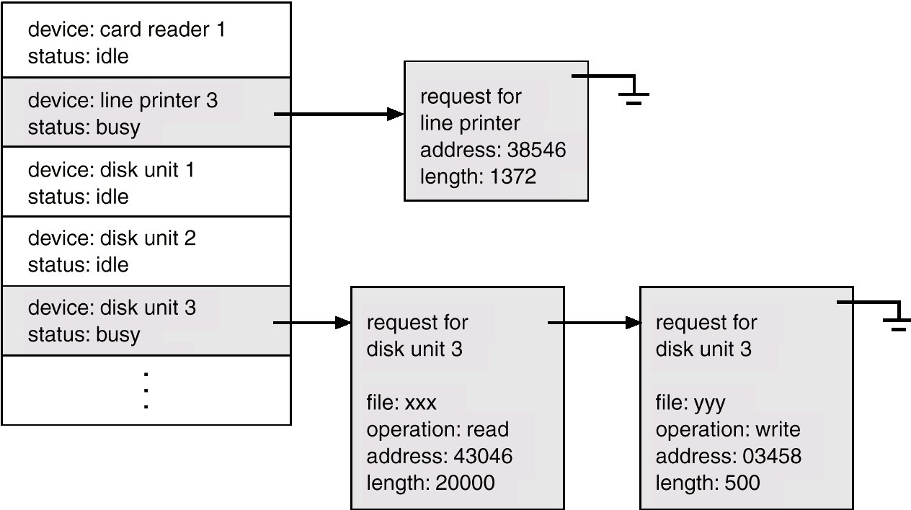
Device Status Table
9

Slide 23
A Question
The operating system
Gets an input
Performs a computation
Produces an output
And Quits
Yes or no?
The operating system is a Reactive Program

Slide 24
Operating System
Modern Operating Systems are Interrupt driven
If
No process to execute
No I/O device to service
No user to whom to respond
Then
OS will sit quietly, waiting for something to happen
This something is Interrupt
At a particular time either a user program is running or operating system is running

Slide 25
Interrupts
 Interrupts are signals by external devices, normally I/O devices.They tell the CPU to stop its current activities and execute the appropriate part of the operating system.

Slide 26
Types of Interrupts
There are three (or broadly two) types of interrupts:
Hardware Interrupts
Software Interrupts
Traps

Slide 27
Hardware Interrupts
 Hardware Interrupts - generated by hardware devices to signal that they need some attention from the OS.
 They may have just received some data (e.g., keystrokes on the keyboard or an data on the Ethernet card);
 or they have just completed a task which the operating system previously requested, such as transferring data between the hard drive and memory.

Slide 28
Software Interrupts
 Software Interrupts are generated by programs when they want to request a system call to be performed by the operating system.

Slide 29
Traps
 Traps are generated by the CPU itself to indicate that some error or condition occurred for which assistance from the operating system is needed.

Slide 30
Interrupts and Traps
Interrupts are hardware interrupts, while traps are software- invoked interrupts.
The term Trap is used interchangeably with the term Exception (which is an automatically occurring software interrupt).

Slide 31
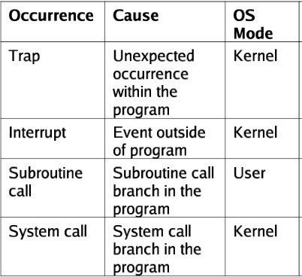
Interrupts and Traps

Slide 32
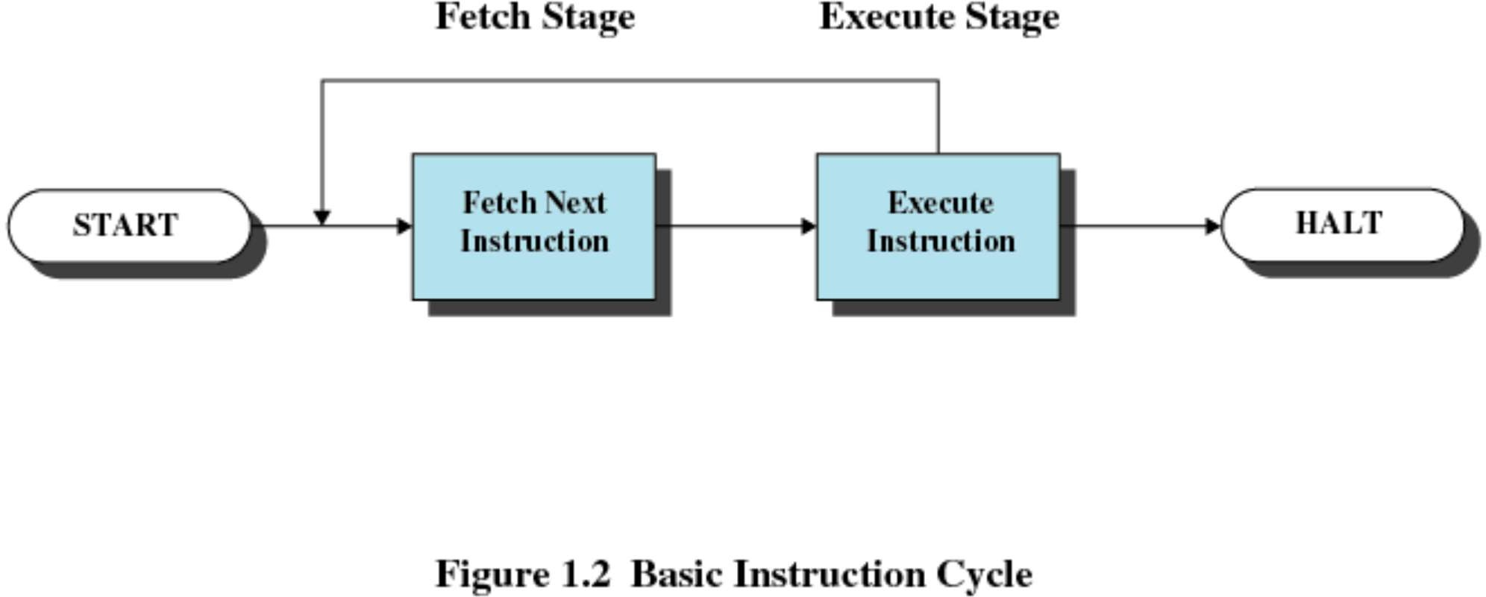
Simple Instruction Cycle
23

Slide 33
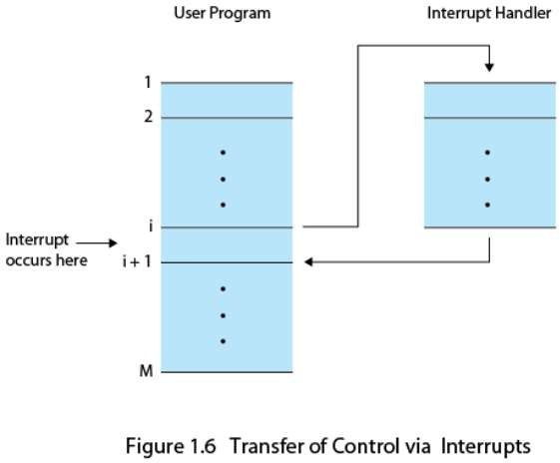
Interrupts
Suspends the normal sequence of execution
Used to improve processor utilization

Slide 34
Interrupt Handling
Different routines handle different type of interrupts.
Called Interrupt Service Routine (ISR)
When the CPU is interrupted it stops what it is doing
The address of the interrupted instruction is saved
A generic routine is run
This routine examines the nature of interrupt
Calls the corresponding ISR
The ISR’s are usually stored in the lower part of the memory
After the interrupt is serviced, the saved address is loaded to the Program Counter
The Interrupted computation can resume as though the interrupt had not occurred.

Slide 35
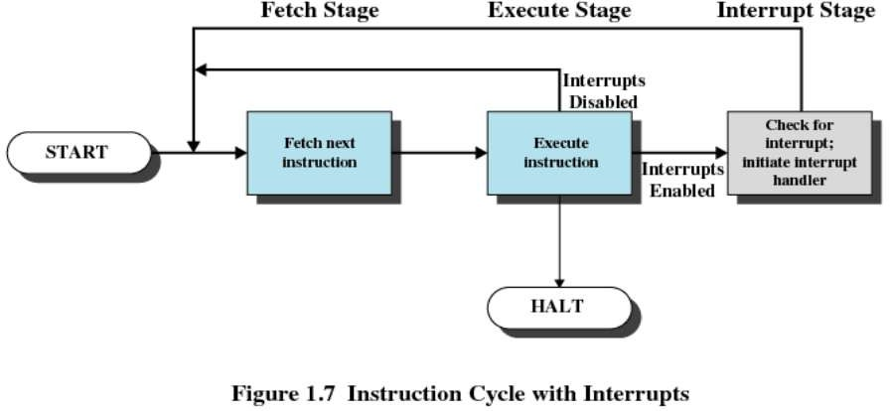
Interrupt Cycle

Slide 36
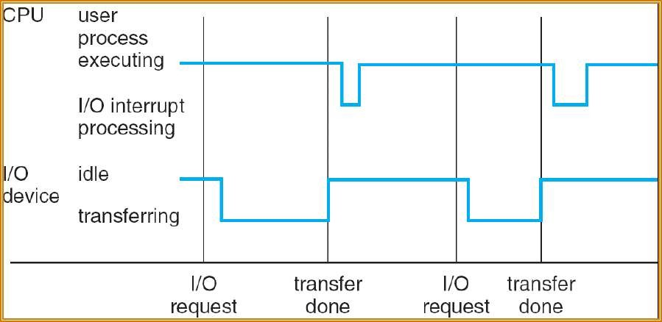
Interrupt Timeline
27

Slide 37
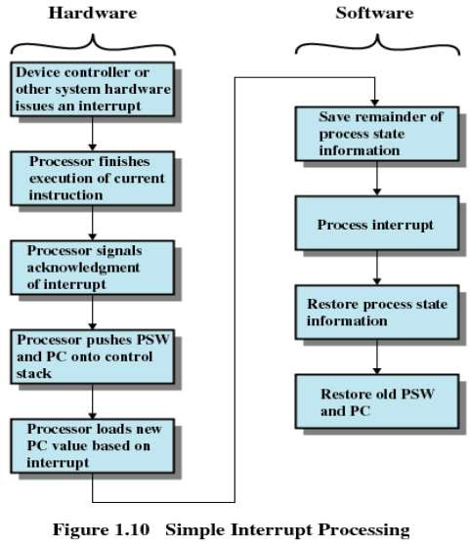
Simple Interrupt Processing
28

Slide 38
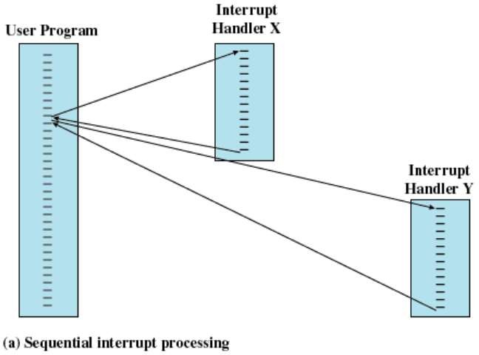
Multiple Interrupts
 Disable interrupts while an interrupt is being processed
29

Slide 39
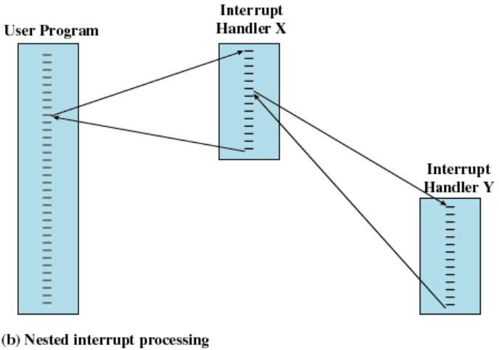
Multiple Interrupts
 Define Priorities for interrupts
30

Slide 40
I/O Control
How does the kernel notice an I/O has finished?
Polling
Hardware interrupt

Slide 41
I/O Control (Cont’d)
Device interrupts
CPU stops current operation, switches to kernel mode, and
saves current PC and other state on kernel stack
CPU fetches proper vector from vector table and branches to
that address (to routine to handle interrupt)
Interrupt routine examines device database and performs action required by interrupt
Handler completes operation, restores saved (interrupt state) and returns to user mode (or calls scheduler to switch to another program)

Slide 42
I/O Interrupts
I/O requested by user program
Control transferred to OS
The Device Driver loads appropriate registers within the device controller
The device controller examines their contents
 If Read request:Transfer data from device to local buffer
Once the data transfer is complete informs the CPU by interrupt

Slide 43
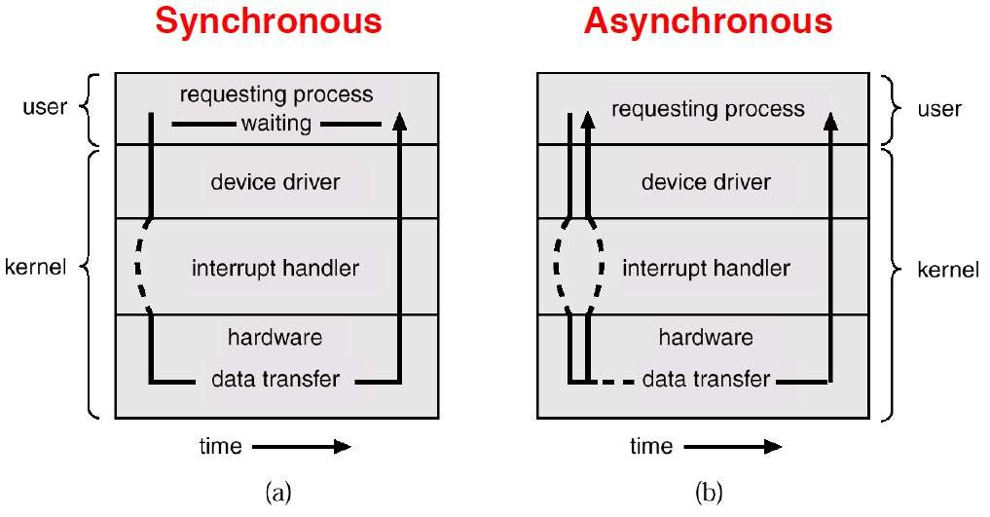
Two I/O methods

Slide 44
1. Synchronous I/O
The OS makes the CPU wait till the I/O complete interrupt is generated
How can a CPU wait, somehow it has to do F->D->E ??
Wait can be accomplished by jumping to an infinite loop code in OS:
Loop: jump Loop
If the devices does not support interrupts
They will just set a flag in their register to indicate I/O complete
The above loop would require to include Polling such devices as well

Slide 45
1. Synchronous I/O
If the CPU always has to wait for the I/O completion then the number of outstanding I/O requests is?
 Exactly One
So, whenever the I/O complete interrupt is generated the OS knows the source device
Drawback?
Excludes concurrent I/O operations to several devices

Slide 46
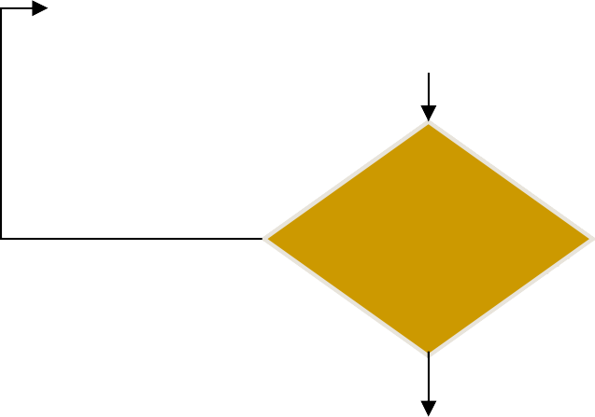
1. Synchronous I/O
Issues Read command to I/O module
CPU -> I/O
Read status of I/O module
I/O -> CPU
Not Ready
Check Status
Error Condition
Ready
Read word from I/O module
I/O -> CPU
Write word into memory
CPU -> memory
No
Done
35
Yes?
Next Instruction

Slide 47
2. Asynchronous I/O
Start the I/O request
Return control immediately to the user process
If the current user program cant run without the I/O, let the current process wait
CPU: Schedule some other user program or operating system code
If no process ready to run, then still need the idle loop

Slide 48
2. Asynchronous I/O
The number of outstanding I/O requests is?
 More then One
Need to keep track of multiple I/O requests

Slide 49
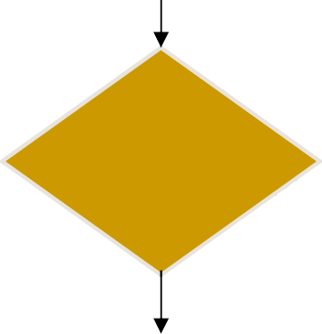
2. Asynchronous I/O
Issues Read command to I/O module
CPU -> I/O
Do something else
Read status of I/O module
^{I/O -> CPU} Interrupt
Check Status
Error Condition
Ready
Read word from I/O module
I/O -> CPU
Write word into memory
CPU -> memory
No
Done
Ye?s
Next Instruction

Slide 50
2. Asynchronous I/O
The I/O controller interrupts when it needs to be serviced
The OS determines the I/O controller
Processor reads the word of data from I/O controller to the memory
Updates the status in the Device Status table
In case of I/O complete interrupt, checks the additional request
The control is returned to the user program

Slide 51
3. Direct Memory Access (DMA)
Drawback of Asynchronous I/O?
Any data transfer must traverse a path through the processor
In case of DMA, the following info to the DMA module:
Read or Write request
Address of the I/O device
Starting location in memory to read from or write to
Number of words
The DMA module is then asked to start data transfer
The above operations are performed by Device Driver

Slide 52
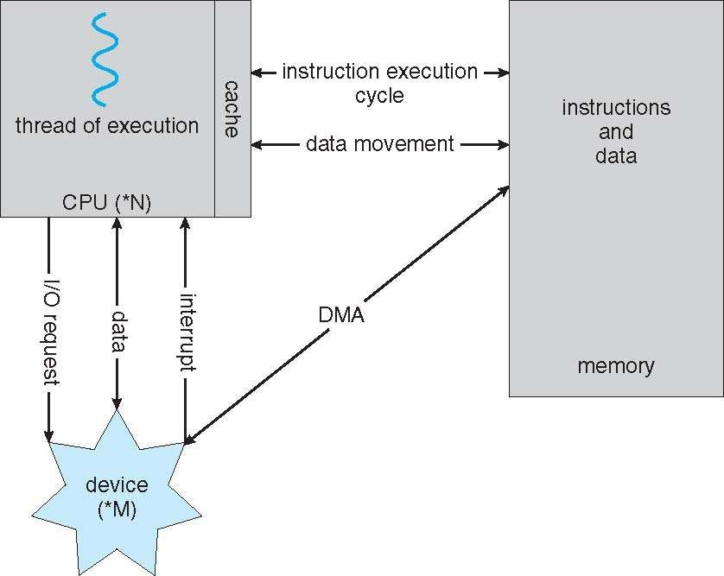
How a Modern Computer Works
A von Neumann architecture

Slide 53
3. Direct Memory Access
The processor can continue with its work
The DMA module transfer data directly from the device to the main memory
But how many accesses to memory are possible at a time
In order to do so, it has to “steal” cycles from processor…Cycle Stealing
Since, only one access to memory is possible at a time

Slide 54
3. Direct Memory Access
The processor has to wait in the mean while for memory
This would slow down the processor
But still more efficient than the previous two cases
After the block transfer is completed, a single I/O interrupt will be generated by the DMA module.

Slide 55
3. Direct Memory Access
Issues Read command to I/O module
CPU -> DMA
Do something else
Read status of DMA module
Interrupt DMA -> CPU
Yes
Next Instruction
Direct Memory Access

Slide 56
Direct Memory Access (DMA)
Used for high-speed I/O devices able to transmit information at close to memory speeds
Device controller transfers blocks of data from buffer storage directly to main memory without CPU intervention
Only one interrupt is generated per block, rather than the one interrupt per byte
Bus arbitration between cache-memory and DMA transfers
Memory cache must be consistent with DMA
45

Slide 57
Interrupts and Exceptions
Interrupts
Generated by hardware devices
Triggered by a signal in INTR or NMI pins (Pentium)
Asynchronous
Exceptions
Generated by software executing instructions
INT instruction in IA32
Page fault, protection fault
Synchronous
Trap (expected) or fault (unexpected)

Slide 58
Reference
Chapter 1, Operating Systems by William Stallings
http://www.cs.toronto.edu/~demke/469F.06/Lectures/Lecture6.pdf
http://www.tldp.org/LDP/tlk/dd/interrupts.html
http://en.wikibooks.org/wiki/Operating_System_Design/Processes/Interrupt
http://www.slideshare.net/guest2e9811e/interrupts
https://amser.org/g11619
http://www.eecs.harvard.edu/~mdw/course/cs161/notes/osstructure.pdf
http://www.sci.brooklyn.cuny.edu/~jniu/teaching/csc33200/files/0910- ComputerSystemOverview02.pdf
http://siber.cankaya.edu.tr/OperatingSystems/ceng328/node87.html
http://www.personal.kent.edu/~rmuhamma/OpSystems/Myos/processControl.htm
http://www.tutorialspoint.com/operating_system/os_processes.htm
http://wiki.answers.com/Q/Explain_process_control_block
https://msdn.microsoft.com/en-us/library/windows/desktop/aa365683(v=vs.85).aspx

